Slide 1
SWEN90016 Software Processes & Project Management
Project Scheduling
2019 – Semester 1
Tutorial 5
Copyright University of Melbourne 2018

Slide 2
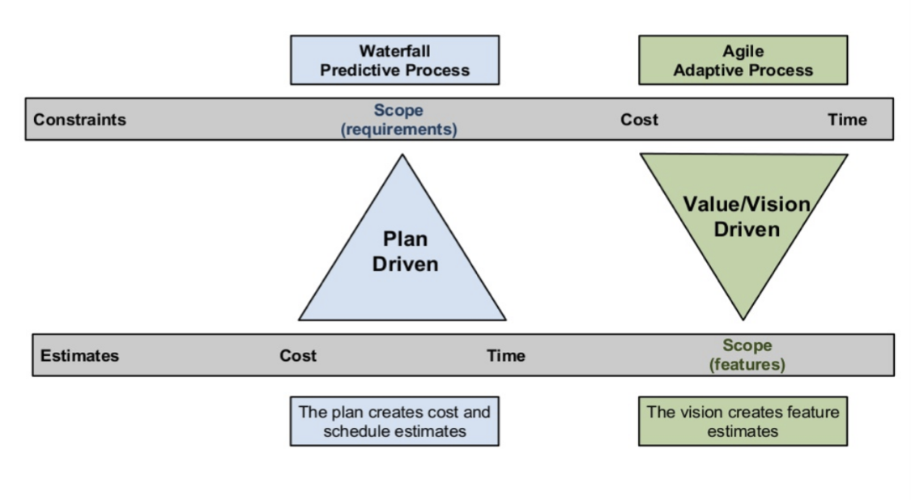
Today’s aim
How to plan and control the schedule of software projects.

Slide 3
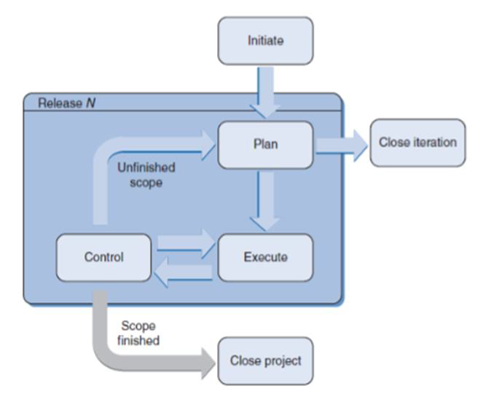
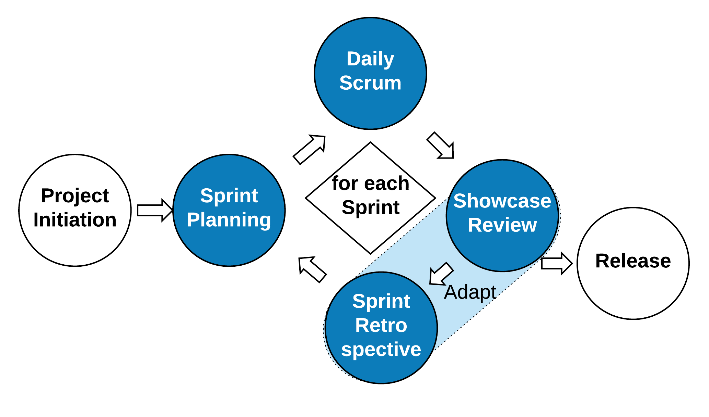
Software Projects
Formal PM Stages:
Initiate
Plan
Execute
Monitor & Control
Close
Agile PM Stages:
Initiate
Sprint Plan
Scrum (or Sprint)
Review & Retrospective (or Adapt)
Release

Slide 4
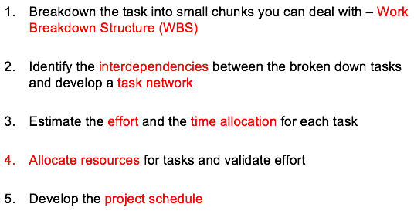
Formal Project Schedule
What steps are involved in developing a project schedule?
Identify tasks
(breakdown to tasks)
Identify dependencies
(task network tool)
Lecture 6, Slide 20
Estimate duration & resources
(staff, hardware, artefacts)
Construct schedule
(allocate dates, resources)

Slide 5
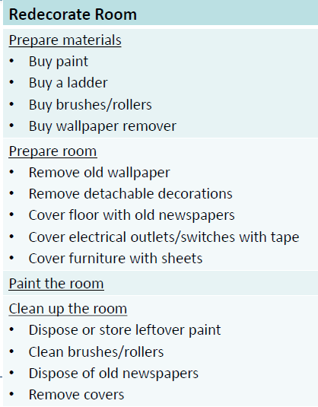
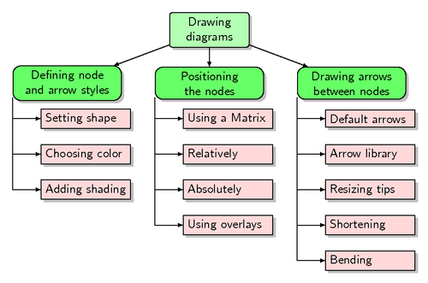
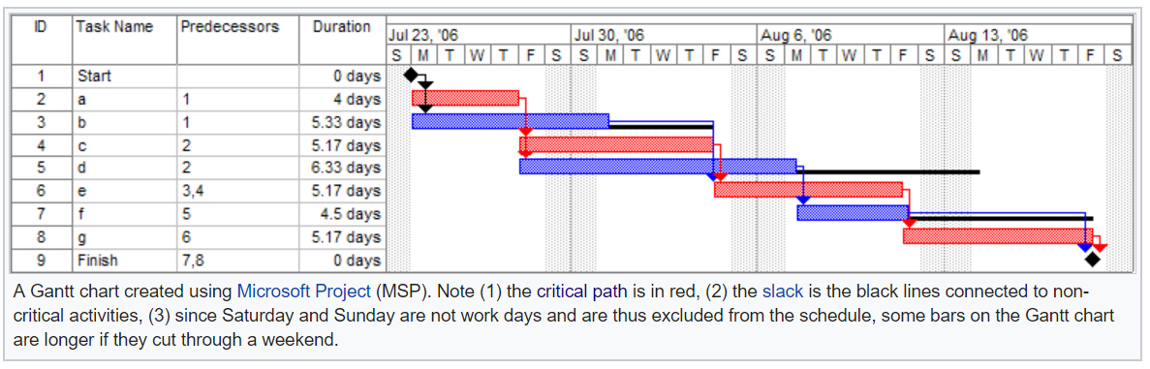
Formal Project Scheduling
1. Work Breakdown Structure
how to plan the schedule
4
6
10
10
4
14
d
f
0
4
4
9
5
15
15
5
19
a
4
5
9
0
0
4
c
End
2. PERT Chart
Start
4
0
9
0
5
5
9
5
14
14
5
19
b
e
g
4
4
9
9
0
14
14
0
19
3. Gantt Chart

Slide 6
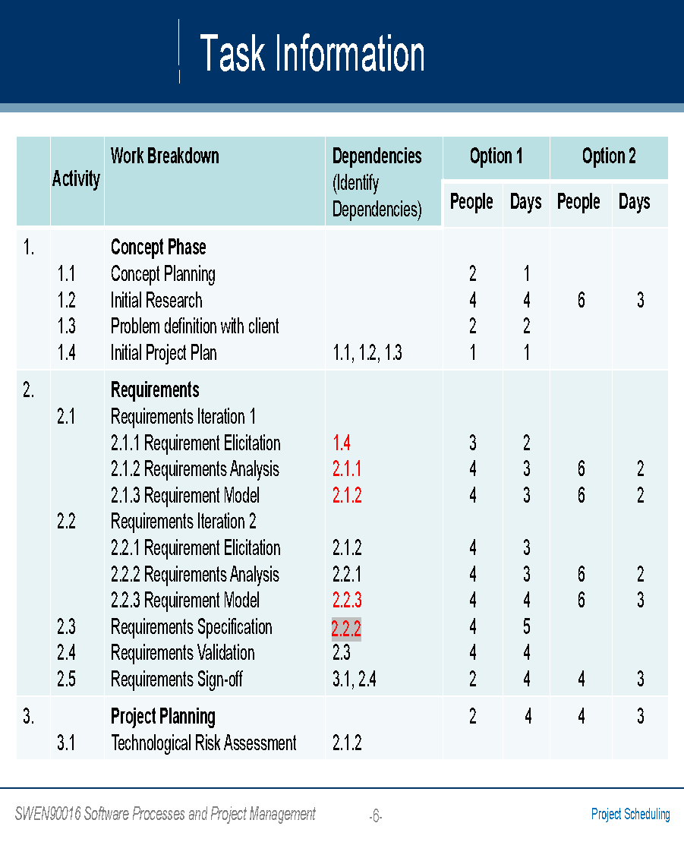

Identify Tasks - Work Breakdown
2.2.2

Slide 7
Identify Dependencies
 | Activity | Work Breakdown | Dependencies predecessor | Duration
1. | 1.1 1.2 1.3 1.4 | Concept Phase Concept Planning Initial Research Problem definition with client Initial Project Plan | 1.1, 1.2, 1.3 | 1 4 2 1
2. | 2.1 2.2 2.3 2.4 2.5 | Requirements Requirements Iteration 1 2.1.1 Requirement Elicitation 2.1.2 Requirements Analysis 2.1.3 Requirement Model Requirements Iteration 2 2.2.1 Requirement Elicitation 2.2.2 Requirements Analysis 2.2.3 Requirement Model Requirements Specification Requirements Validation Requirements Sign-off | 1.4 2.1.1 2.1.2 2.1.2 2.2.1 2.2.2 2.2.3 2.3 3.1, 2.4 | 2 3 3 3 3 4 5 4 4
3. | 3.1 | Project Planning Technological Risk Assessment | 2.1.2 | 4

Slide 8
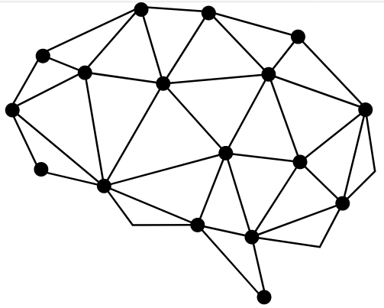
Identify Dependencies
Develop a task network
(activity on node)
given dependencies
 | activity | predecessor | duration
1 | 1.1 |  | 1
2 | 1.2 |  | 4
3 | 1.3 |  | 2
4 | 1.4 | 1.1 1.2 1.3 | 1
5 | 2.1.1 | 1.4 | 2
6 | 2.1.2 | 2.1.1 | 3
7 | 2.1.3 | 2.1.2 | 3
8 | 2.2.1 | 2.1.2 | 3
9 | 2.2.2 | 2.2.1 | 3
10 | 2.2.3 | 2.2.2 | 4
11 | 2.3 | 2.2.3 | 5
12 | 2.4 | 2.3 | 4
13 | 2.5 | 2.4 3.1 | 4
14 | 3.1 | 2.1.2 | 4

Slide 9
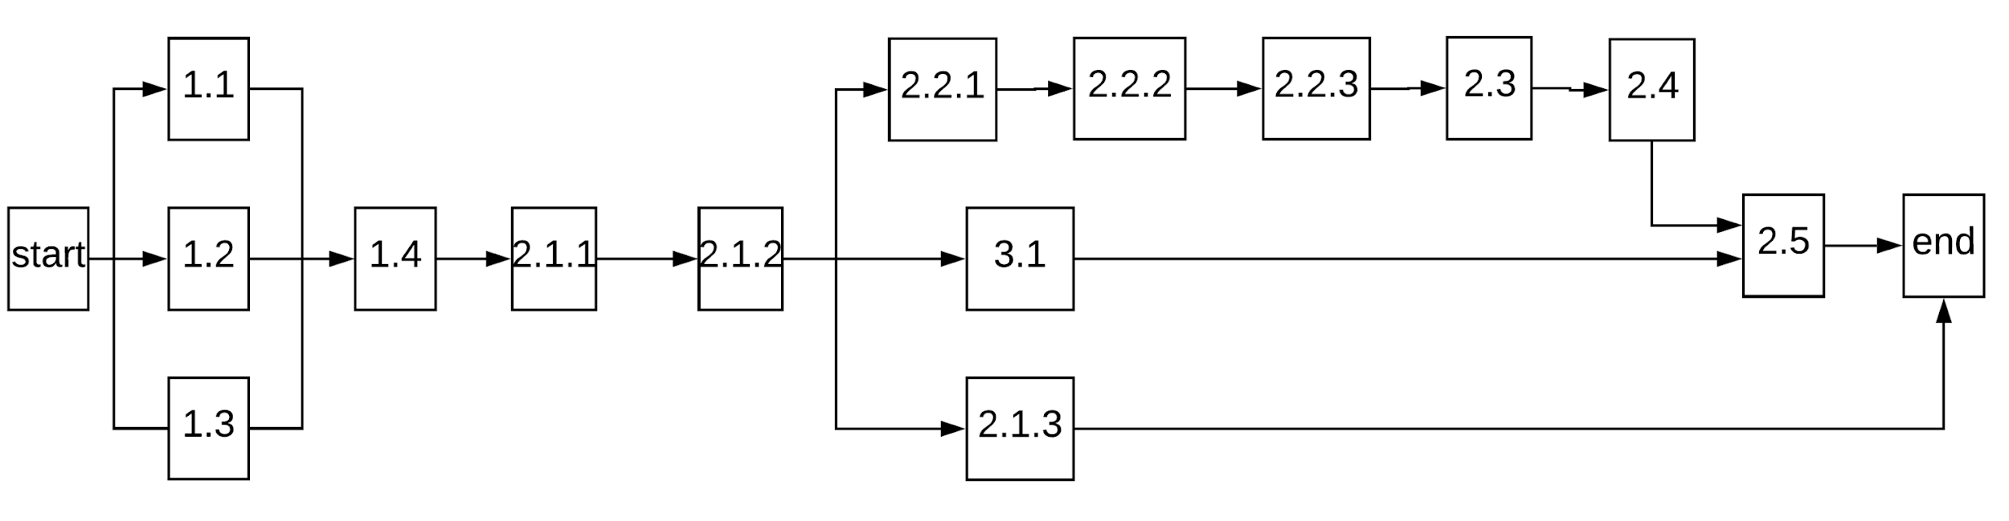
Task Network
Network Diagram
Sequential nodes
Few details

Slide 10
Pert Chart
PERT: Program Evaluation & Review Technique
Earliest start time (ES)
Duration in people days
Earliest finish time (EF)
ES
Duration
EF
Task Name
LS
Slack
LF
Latest start time (LS)
Slack time
Latest finish time (LF)
The activity node

Slide 11
Pert Chart: example
Show a PERT chart: use task durations & task network diagram
Activity | Duration
A | 4
B | 5
C | 5
D | 6
E | 5
F | 4
G | 5
ES
Duration
EF
Task Name
Task Network Diagram
LS
Slack
LF
D
F
A
C
4 |  | 9
Finish
Start
B
E
G

Slide 12
Forward Pass
Activity | Duration
A | 4
B | 5
C | 5
D | 6
E | 5
F | 4
G | 5
ES
Duration
EF
Task Name
LS
Slack
LF
4 | 6 | 10
D
10 | 4 | 14
F
0 | 4 | 4
A
4 | 5 | 9
C
4 |  | 9
Finish
19
Start
0 | 5 | 5
B
9 | 5 | 14
E
14 | 5 | 19
G

Slide 13
Backward Pass
Activity | Duration
A | 4
B | 5
C | 5
D | 6
E | 5
F | 4
G | 5
ES
Duration
EF
Task Name
LS
Slack
LF
4 | 6 | 10
D
9 |  | 15
10 | 4 | 14
F
15 |  | 19
0 | 4 | 4
A
0 |  | 4
4 | 5 | 9
C
4 |  | 9
Finish
19
Start
0 | 5 | 5
B
4 |  | 9
9 | 5 | 14
E
9 |  | 14
14 | 5 | 19
G
14 |  | 19

Slide 14
Slack
Activity | Duration
A | 4
B | 5
C | 5
D | 6
E | 5
F | 4
G | 5
ES
Duration
EF
Task Name
LS
Slack
LF
4 | 6 | 10
D
5 | 5 | 15
10 | 4 | 14
F
15 | 5 | 19
0 | 4 | 4
A
0 | 0 | 4
4 | 5 | 9
C
4 | 0 | 9
Finish
19
Start
0 | 5 | 5
B
4 | 4 | 9
9 | 5 | 14
E
9 | 0 | 14
14 | 5 | 19
G
14 | 0 | 19

Slide 15
Critical Path
Critical Path = A + C + E + G
4 | 6 | 10
D
5 | 5 | 15
10 | 4 | 14
F
15 | 5 | 19
0 | 4 | 4
A
0 | 0 | 4
4 | 5 | 9
C
4 | 0 | 9
Finish
19
Start
0 | 5 | 5
B
4 | 4 | 9
9 | 5 | 14
E
9 | 0 | 14
14 | 5 | 19
G
14 | 0 | 19

Slide 16
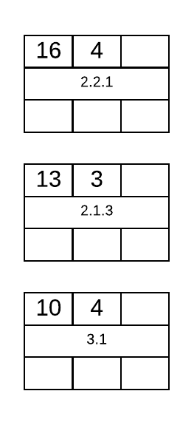
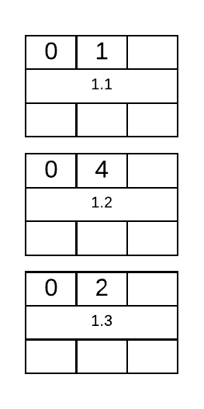
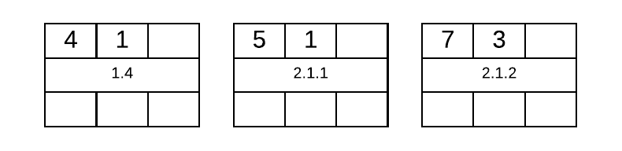
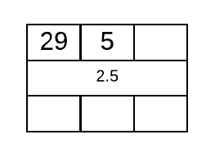
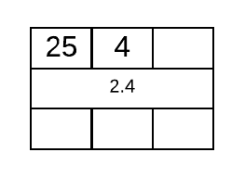
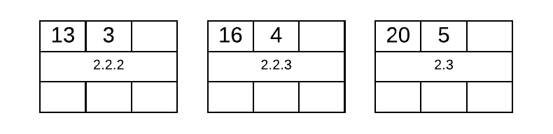
PERT Chart: activity
Use duration estimates & task network to construct PERT chart
activ | durn
1.1 | 1
1.2 | 4
1.3 | 2
1.4 | 1
2.1.1 | 2
2.1.2 | 3
2.1.3 | 3
2.2.1 | 3
2.2.2 | 3
2.2.3 | 4
2.3 | 5
2.4 | 4
2.5 | 4
3.1 | 4
3
2

Slide 17
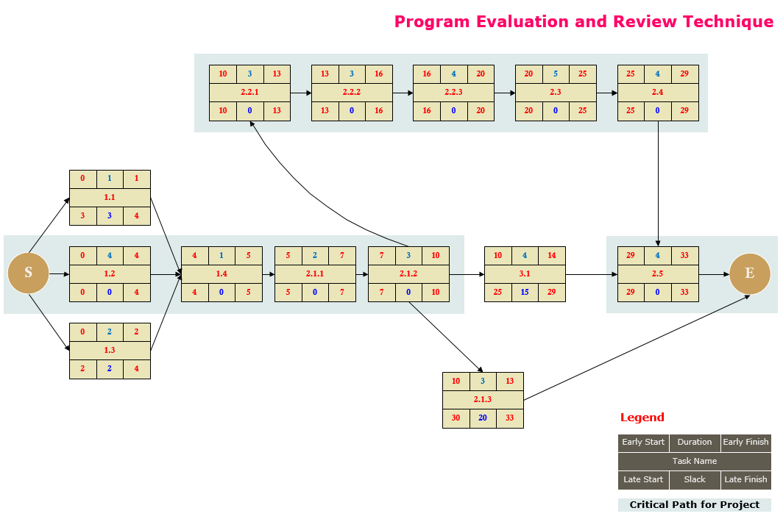
PERT Chart
ES
Duration
EF
Task Name
Critical Path = 1.2 + 1.4 + 2.1.1 + 2.1.2 + 2.2.1 + 2.2.2 + 2.2.3 + 2.3 + 2.4 + 2.5
LS
Slack
LF

Slide 18
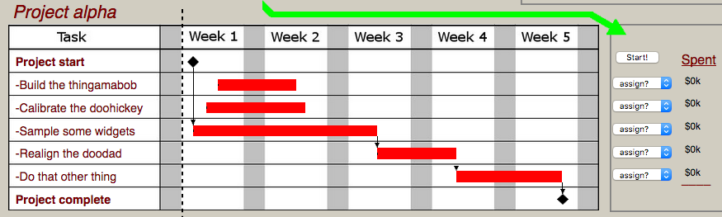
Construct Resource Schedule
Play the Project Management Game:
http://thatpmgame.com/
Use a Gantt chart to assign staff to various tasks.
Is the project completed on time and on budget?

Slide 19
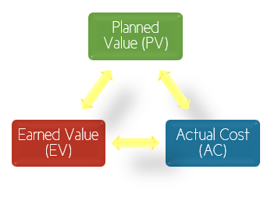
Monitoring and Control
how to control
Planned Value
initial expected value of task
best assignment worth 30%
Earned Value
the current value of the task,
given 1) the expected work rate,
and 2) the work done up until now
assignment not started, …
- what is it worth ?
☹
final actual value of task
Actual Cost

Slide 20
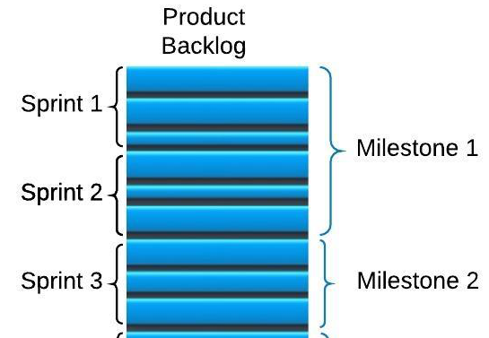
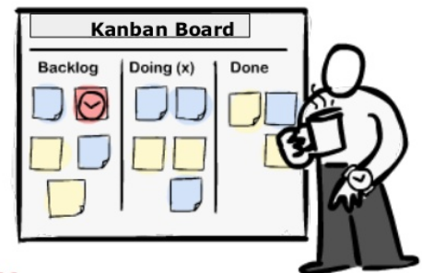

Scrum Project Scheduling
1. Product Backlog with milestones
2. Sprint Backlog on Kanban board
3. Burndown Charts
how to plan the schedule

Slide 21
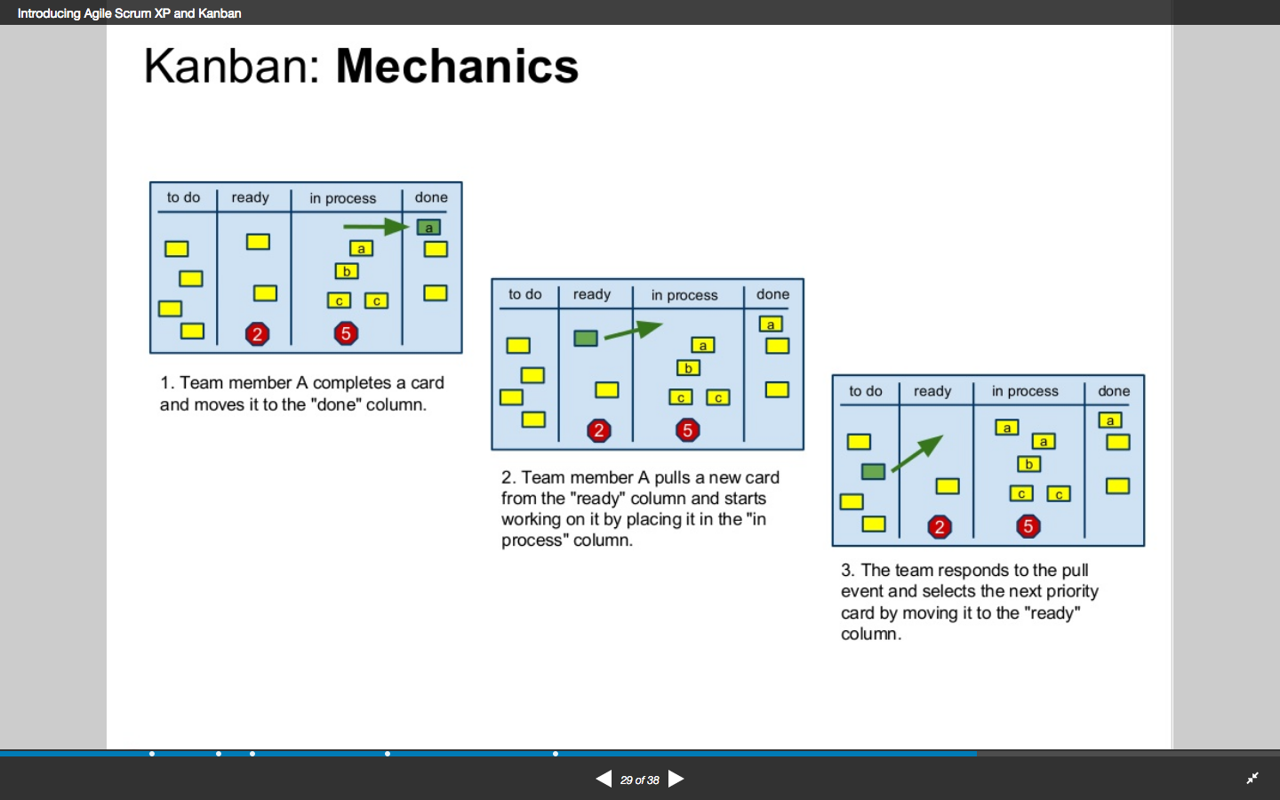
Velocity and Visual Board
How many User Stories are “done” over the time-boxed Sprint?
Only count 100% complete stories
Predict when the release milestones will be reached
From Lecture 7, slide 77
Swimlane
Board
Product
Backlog
Sprint
Backlog
Team member A completes code for a card and moves it to “done”
The Product Owner selects the next priority set of cards (Sprint Backlog) and moves it to “ready”
Team member A “pulls” a new card from “ready” and moves it to “doing”

Slide 22
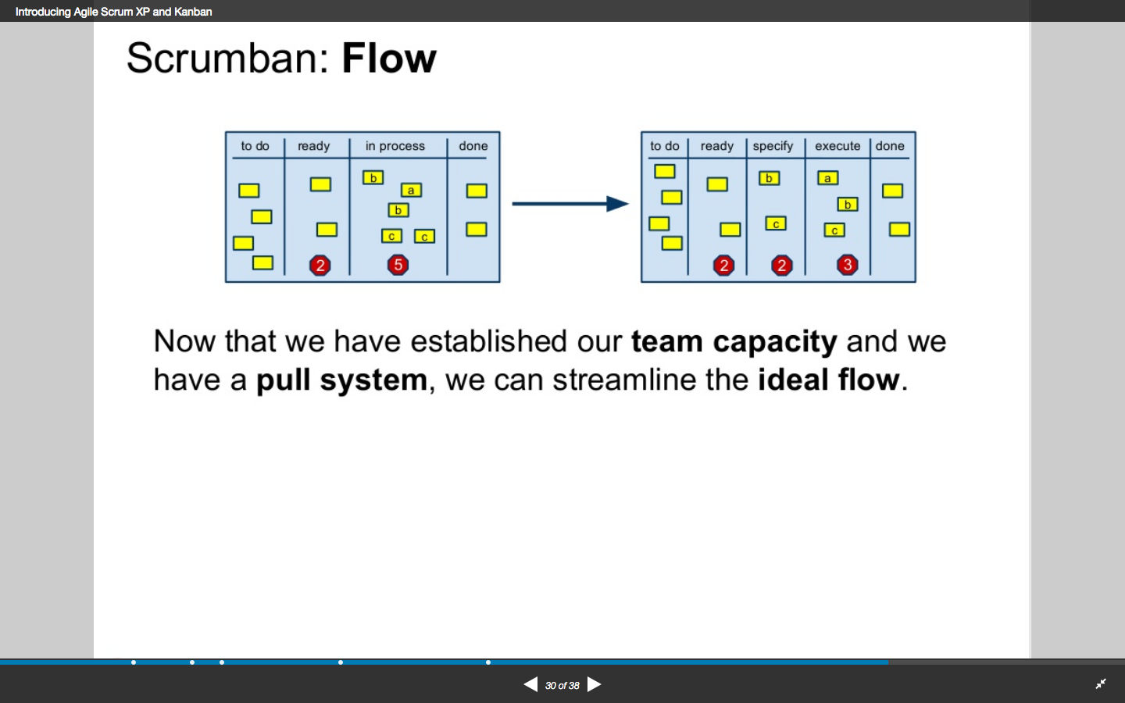
Agile Scrum Velocity
Velocity determines when dev team can deliver
Dev team velocity emerges over a number of Sprints
Predict when the release milestones will be reached

Slide 23
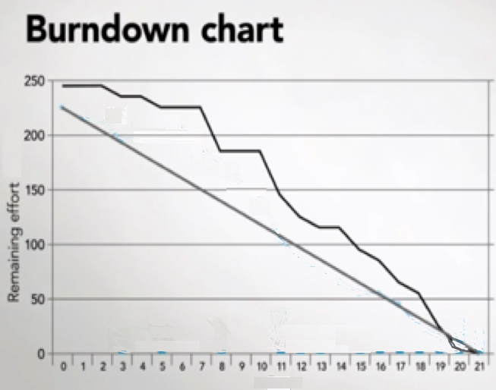
Agile Scrum Velocity
Velocity determines the slope of the BurnDown charts
The Scrum master can track remaining effort
Predict when the release milestones will be reached
next week’s tutorial ☺
Y-axis: effort
X-axis: time

Slide 24
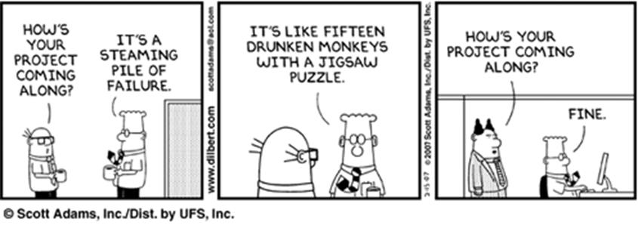
Thank You!

